Slide 1


Department of Information Technology
AI-DRIVEN ECG IMAGE ANALYSIS AND CLINICAL INTERPRETATION SYSTEM​
Project Guide:
Dr. Y. Suresh
Project Team Members:
BarathKumar S (61781922106014)
Dharanidharan S (61781922106021)
Dharshana Devi S (61781922106022)

Slide 2
Abstract
Cardiovascular diseases (CVDs) are a leading global cause of death, requiring fast and accurate cardiac diagnosis
Traditional ECG interpretation depends on expert knowledge, is time‑consuming, and prone to human error
Automatically preprocesses ECG images and classifies cardiac conditions like arrhythmia, myocardial infarction
Generative AI with NLP produces detailed clinical reports including diagnosis, causes, treatment, and recovery guidance
Smart, user‑friendly decision‑support tool for clinicians, students, and telemedicine platforms

Slide 3
Introduction
Develop an intelligent system for automatic analysis of ECG images
Accurately identify and classify cardiac abnormalities such as arrhythmia, myocardial infarction, tachycardia, and bradycardia
Generate human‑readable clinical interpretations using AI and NLP techniques
Provide insights including possible causes, treatment recommendations, and recovery guidelines
Support healthcare professionals, medical students, and telemedicine platforms by improving diagnostic speed, accuracy, and reliability while reducing human effort and errors

Slide 4
Existing System
Dependence on manual ECG interpretation, making diagnosis time‑consuming, costly, and prone to human error.
Lack of image‑based ECG analysis, limiting usability with scanned or photographed ECG reports
Limited cardiac condition classification, unable to handle multiple or diverse heart abnormalities
Absence of clinical interpretation and report generation, providing only labels without actionable medical insights
Poor usability and limited telemedicine support, reducing adoption in remote healthcare and by non‑expert users
Poor generalization across diverse populations and ECG recording conditions, leading to reduced reliability and safety in real‑world clinical environments

Slide 5
Need for Proposed System
To reduce reliance on manual ECG interpretation, which is time‑consuming and prone to human error
To enable image‑based ECG analysis, supporting scanned and photographed ECG reports commonly used in clinical and telemedicine settings
To provide accurate classification of multiple cardiac conditions rather than limited or single‑disease detection
To generate human‑readable clinical interpretations, making ECG results understandable to non‑specialists
To support fast and reliable diagnosis in remote and underserved areas through intelligent automation
To offer a user‑friendly decision‑support system that improves diagnostic accuracy, efficiency, and patient outcomes

Slide 6
Proposed System
Proposed System – Overview
AI‑Driven ECG Image Analysis and Clinical Interpretation System
End‑to‑end automated solution from ECG image upload to report generation
Eliminates dependency on manual ECG interpretation
Designed for hospitals, clinics, medical education, and telemedicine
System Workflow
Upload ECG image through a user‑friendly interface
Preprocessing of ECG image to enhance waveform quality
Deep learning‑based cardiac condition classification
Generative AI module produces detailed clinical report
Instant delivery of results to the user

Slide 7
Proposed System
ECG Image Preprocessing & Feature Extraction
Noise removal and contrast enhancement
Conversion to grayscale for consistency
Segmentation of ECG waveforms (P wave, QRS complex, T wave)
Ensures accurate and reliable feature extraction
Deep Learning‑Based Cardiac Classification
Uses Convolutional Neural Networks (CNN)
Automatically learns complex waveform patterns
Classifies conditions such as :
a. Arrhythmia, Myocardial Infarction
b. Tachycardia, Bradycardia
c. Normal Sinus Rhythm

Slide 8
Proposed System
Generative AI‑Based Clinical Interpretation
Converts model output into human‑readable text Provides:
a. ECG waveform interpretation
b. Possible diagnosis
c. Causes of abnormalities
d. Treatment recommendations
e. Recovery and follow‑up guidelines

Slide 9
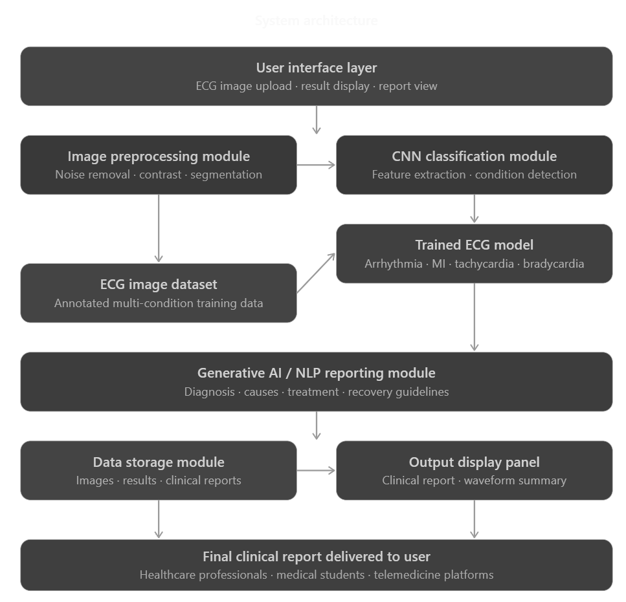
Architecture Diagram

Slide 10
Technology Used
Convolutional Neural Networks (CNN)
Used for ECG image feature extraction and multi‑class cardiac disease classification
Image Processing Techniques
Includes noise removal, contrast enhancement, grayscale conversion, and waveform segmentation
Natural Language Processing (NLP)
Converts diagnostic outputs into human‑readable clinical explanations
Generative AI
Generates detailed clinical reports including diagnosis, causes, treatment, and recovery guidance
Python Programming Language
Used for model development, image processing, and system integration
Deep Learning Frameworks (TensorFlow)
Used to build, train, and deploy CNN models

Slide 11
Module Description
Module 1: ECG Image Upload & Input Module
This module provides a user‑friendly interface that allows users to upload ECG images in common formats such as JPG, PNG, or scanned reports. It serves as the entry point of the system and ensures that ECG images can be easily submitted by healthcare professionals, medical students, or telemedicine platforms without requiring technical expertise.
Module 2: ECG Image Preprocessing Module
The preprocessing module enhances the quality of the uploaded ECG images before analysis. It performs noise removal, contrast enhancement, grayscale conversion, and waveform segmentation. This module ensures that important ECG components such as the P wave, QRS complex, and T wave are clearly visible and accurately extracted for further processing.

Slide 12
Module Description
Module 3: Feature Extraction Module
This module focuses on extracting meaningful features from the preprocessed ECG images. Using deep learning techniques, it automatically learns spatial and waveform patterns present in the ECG images. These extracted features form the basis for accurate cardiac condition classification.
Module 4: Cardiac Disease Classification Module
The classification module uses a Convolutional Neural Network (CNN) trained on annotated ECG image datasets. It classifies the ECG images into different cardiac conditions such as arrhythmia, myocardial infarction, tachycardia, bradycardia, and normal sinus rhythm. This module provides high accuracy and better generalization compared to traditional rule‑based methods.

Slide 13
Module Description
Module 5: Generative AI‑Based Clinical Interpretation Module
This module integrates Generative AI and Natural Language Processing to convert classification results into detailed, human‑readable clinical reports. The generated reports include ECG interpretation, possible diagnosis, causes of abnormalities, treatment recommendations, and recovery guidelines, making the output useful for both specialists and non‑specialists.
Module 6: Report Display & Decision Support Module
The final module presents the generated clinical report to the user in a clear and structured format. It enables instant access to diagnostic insights, supports clinical decision‑making, and can be integrated with telemedicine platforms to assist remote and real‑time cardiac care.

Slide 14
Results & Discussion
The system successfully analyzes uploaded ECG images and produces accurate diagnostic results when image quality is good
The CNN‑based deep learning model achieved an overall classification accuracy of approximately 95%
Cardiac conditions such as arrhythmia, myocardial infarction, tachycardia, bradycardia, and normal sinus rhythm were correctly identified
The Generative AI module generates detailed and clinically meaningful interpretation reports in most cases
Minor inconsistencies may occur in rare edge cases due to language model limitations, with report accuracy around 80% in such scenarios
The system provides real‑time or near real‑time responses, ensuring fast diagnosis and smooth user experience
A user‑friendly interface allows easy ECG image upload and clear presentation of results
Secure data storage and authentication mechanisms protect sensitive diagnostic information

Slide 15
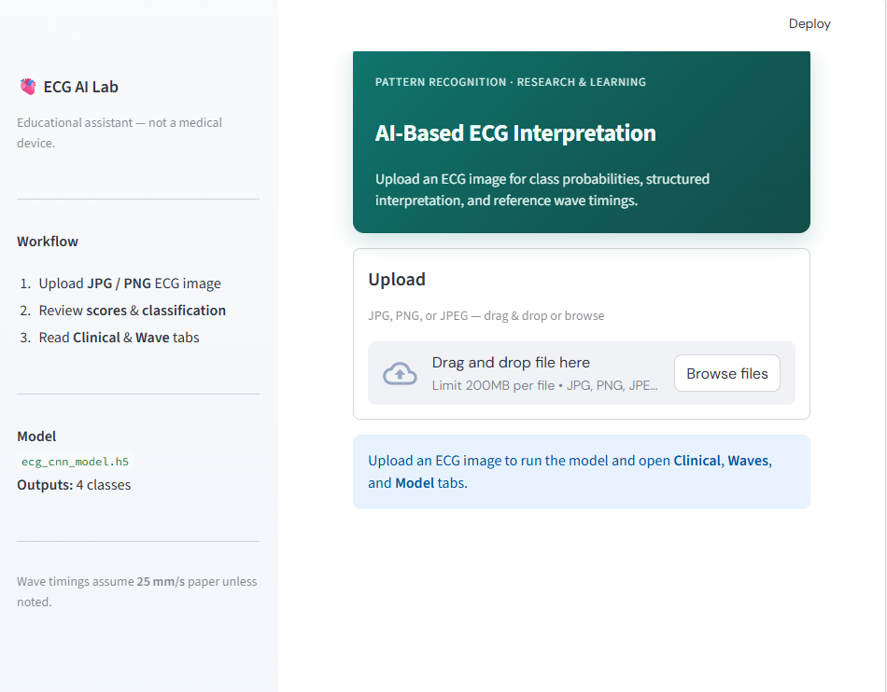
Screenshots
Uploading Image to the ECG

Slide 16
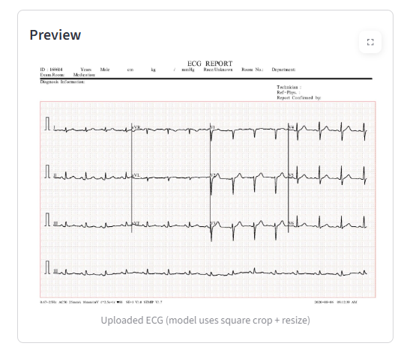
Image Preprocessing

Slide 17
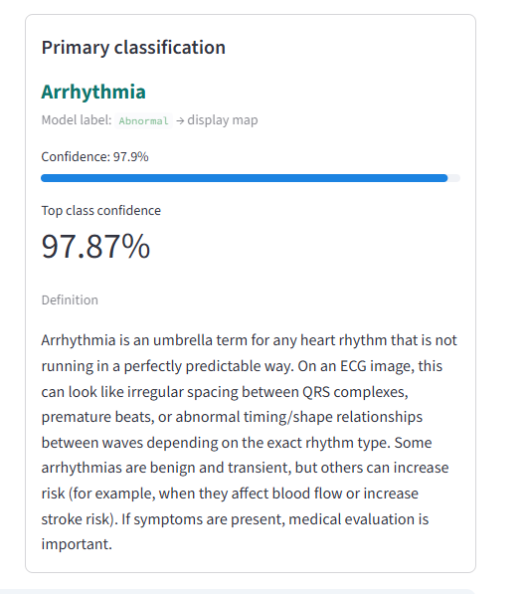
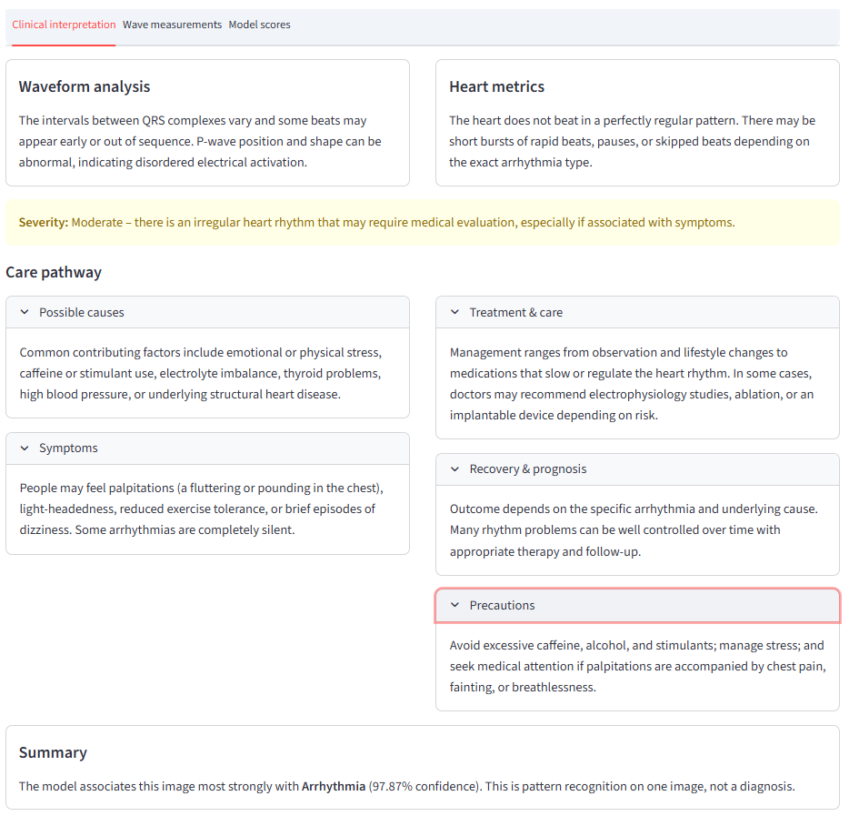
Generative AI Clinical report Creation Module

Slide 18
Conclusion
The AI‑Driven ECG Image Analysis and Clinical Interpretation System successfully demonstrates the application of Artificial Intelligence in cardiac diagnosis
The system integrates ECG image preprocessing, CNN‑based deep learning classification, and Generative AI‑based clinical report generation into a unified platform
It accurately classifies multiple cardiac conditions such as arrhythmia, myocardial infarction, tachycardia, bradycardia, and normal sinus rhythm with an accuracy of about 95%
The Generative AI module enhances clinical usefulness by producing human‑readable and actionable diagnostic reports rather than simple labels
The system delivers real‑time diagnostic responses through a user‑friendly and secure interface, making it accessible to healthcare professionals, students, and telemedicine platforms
Overall, the project proves to be an efficient, reliable, and practical decision‑support tool that improves the accuracy, efficiency, and accessibility of ECG‑based cardiac diagnosis

Slide 19
Future Scope & Enhancements
Expand and diversify the ECG image dataset to improve classification accuracy and handle rare or complex cardiac conditions
Fine‑tune the Generative AI model with medical guidelines and clinical data to reduce hallucinations and improve report reliability
Integrate multimodal data such as patient history, lab reports, vital signs, and wearable device data for comprehensive diagnosis
Implement Explainable AI (XAI) techniques to improve transparency and clinician trust in model decisions
Enhance security features using advanced encryption, role‑based access control, and multi‑factor authentication
Improve scalability and performance using cloud deployment and distributed processing
Extend the system with multilingual report generation, mobile application support, and EHR integration
Introduce continuous learning mechanisms to improve model performance with real‑world ECG data over time

Slide 20
References
Acharya, U. R., Oh, S. L., Hagiwara, Y., Tan, J. H., Adam, M., Gertych, A., and Tan, R. S. (2017). A deep convolutional neural network model to classify heartbeats. Computers in Biology and Medicine, 89, 389–396.
Alday, E. A. P., Gu, A., Shah, A. J., Robichaux, C., Wong, A. K. I., Liu, C., and Reyna, M. A. (2020). Classification of 12-lead ECGs with the PhysioNet Computing in Cardiology Challenge. Physiological Measurement, 41(12), 124003.
Baloglu, U. B., Talo, M., Yildirim, O., San Tan, R., and Acharya, U. R. (2019). Classification of myocardial infarction with multi-lead ECG signals and deep CNN. Pattern Recognition Letters, 122, 23–30.
Chen, T. M., Huang, C. H., Shih, E. S., Hu, Y. F., and Hwang, M. J. (2021). Detection and classification of cardiac arrhythmias by a challenge-best deep learning neural network model. iScience, 23(3), 100886.

Slide 21

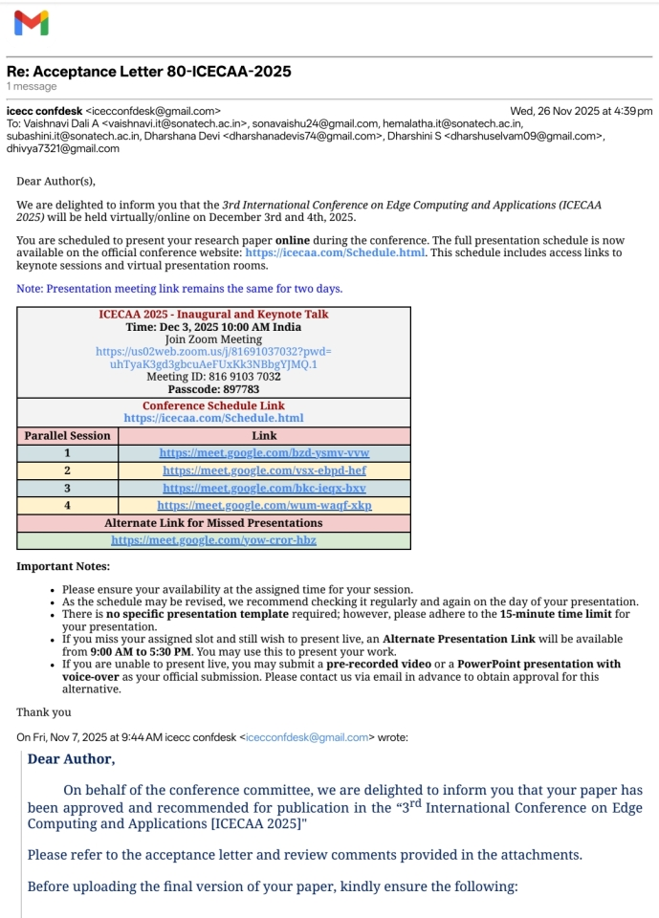
Publication

